Slide 1


Creating a Dynamic Website for Social Enhance
This project is centered around developing a captivating and interactive website for Social Enhance, a forward-thinking company driving transformation in the digital landscape. Specializing in cutting-edge solutions, Social Enhance aims to elevate online experiences, amplify digital presence, and harness the power of social media and technology to enhance brand visibility, connect communities, and drive meaningful engagement.

Slide 2
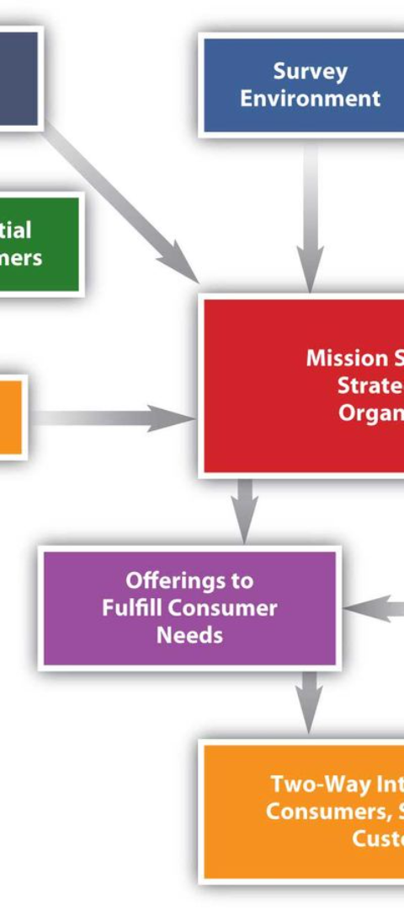
Mission: Reflecting the Ethos of Social Enhance
1
Clear Mission
The mission is crystal clear: to craft a website that represents the core values of Social Enhance and provides an interactive platform for clients, partners, and visitors.
2
Showcasing Innovation
The website will showcase the company's innovative services, technological expertise, and commitment to pushing the boundaries of social and digital enhancement.
3
Brand Visibility
Emphasizing the website's role in enhancing brand visibility, connecting communities, and driving meaningful engagement for Social Enhance.

Slide 3

User-Centric Design: Seamless Navigation & Enjoyable Experience
Seamless Navigation
Enjoyable Experience
The website prioritizes a user-friendly interface to ensure seamless navigation, making it easy for visitors to find the information they need.
Focusing on creating an enjoyable and engaging experience for users, encouraging them to explore the website's offerings.
Modern Design Elements
Incorporating modern and visually captivating design elements that align with the brand identity of Social Enhance, enhancing the overall user experience.

Slide 4
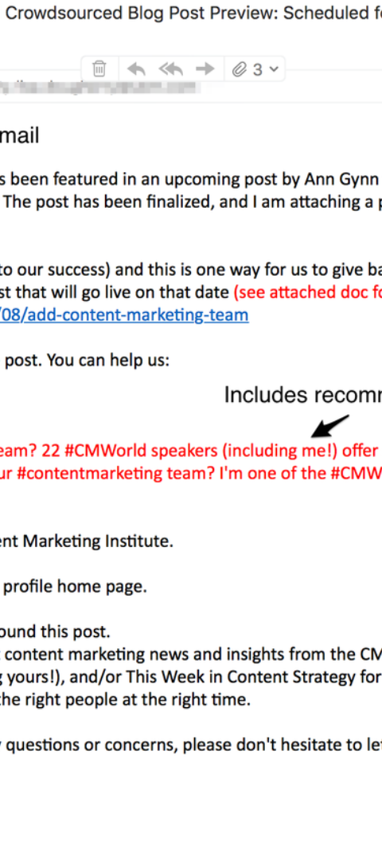

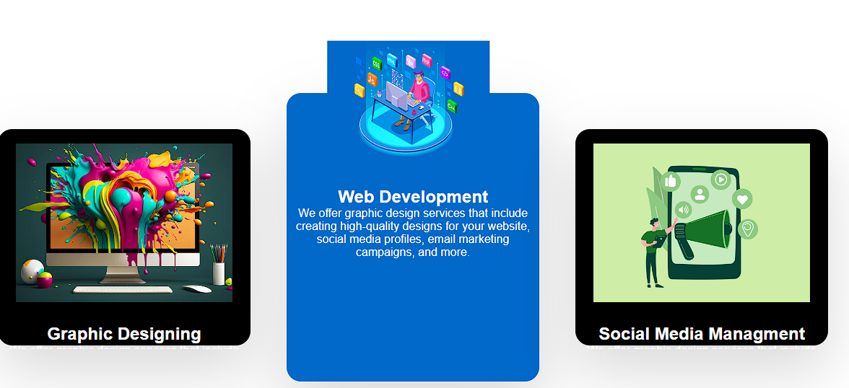

Informative Content: Comprehensive Information Delivery
1
Detailed Services
2
Values Representation
Providing comprehensive information about the diverse range of services offered by Social Enhance, catering to various digital needs.
Showcasing the core values and ethos of Social Enhance through informative content that resonates with the audience.
3
Success Stories
Highlighting success stories and case studies to demonstrate the impact of Social Enhance's services and solutions.

Slide 5
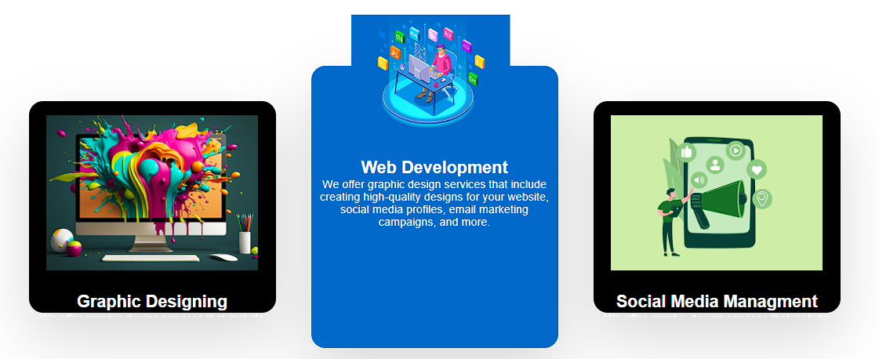
Engagement Features: Encouraging Visitor Interaction
Interactive Features
Contact Mechanism
Inquiries Channels
Implementing interactive elements that encourage visitor interaction, feedback, and inquiries, fostering a sense of community and engagement.
Providing accessible platforms for visitors to share feedback, enabling Social Enhance to understand and respond to their needs more effectively.
Establishing seamless inquiry channels that allow visitors to connect with the company and seek further information or assistance.

Slide 6
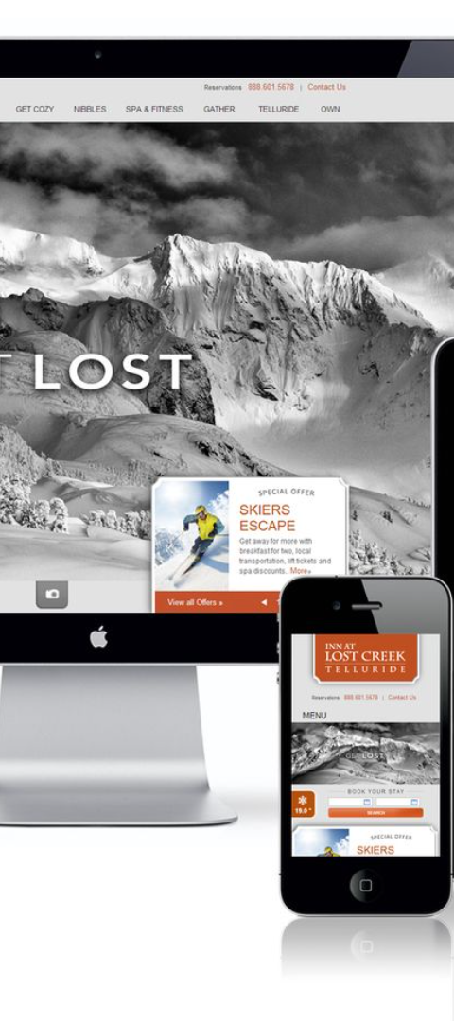
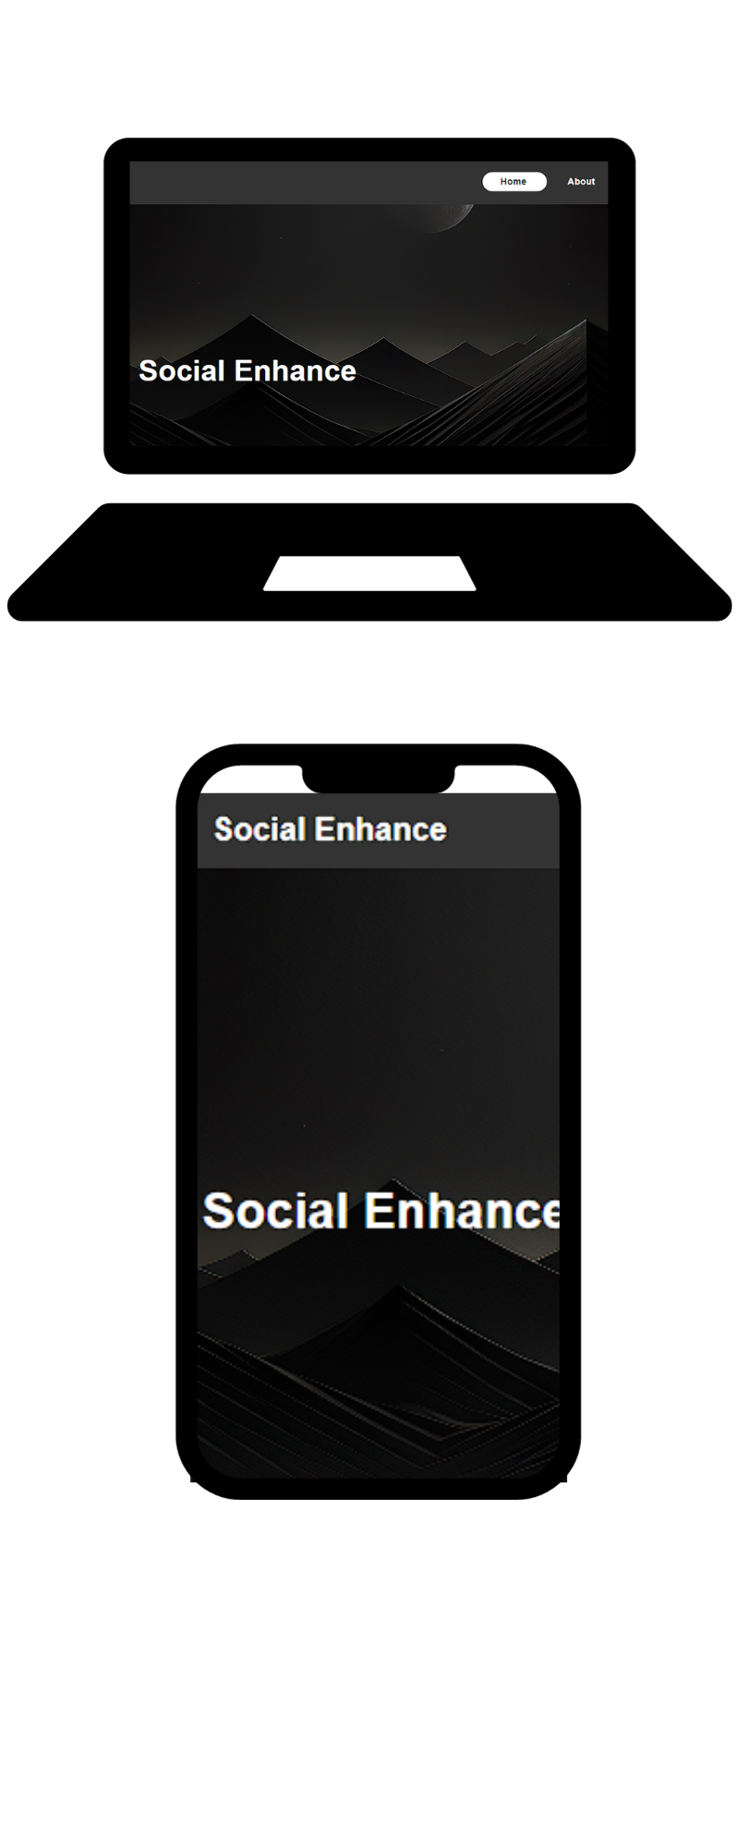



Responsive Design: Accessibility Across Devices
Multi-Device Compatibility
Ensuring the website is accessible and fully functional across various devices, from desktop computers to smartphones and tablets.
Cross-Platform Performance
Optimizing the website's performance to ensure a consistent and high-quality user experience across different platforms and screen sizes.
Adaptive Layouts
Implementing adaptive layouts and flexible design elements to maintain functionality and visual appeal across diverse devices.

Slide 7

Technological Tools: Visual Studio 2023 & Web Browser
Utilizing advanced technological tools including Visual Studio 2023 for robust web development and the powerful Chrome web browser to ensure optimal website performance and compatibility.

Slide 8

Division of Work: Contributions by Mr. Zuhad Ahmed and Mr. Muhammad Armaghan Qazi
The HTML and partial CSS work for the website will be undertaken by Mr. Zuhad Ahmed, ensuring a strong foundation for layout and visual elements. Additionally, Mr. Muhammad Armaghan Qazi will handle the JavaScript programming and contribute to refining the CSS code for a seamless and dynamic user experience.

Slide 9
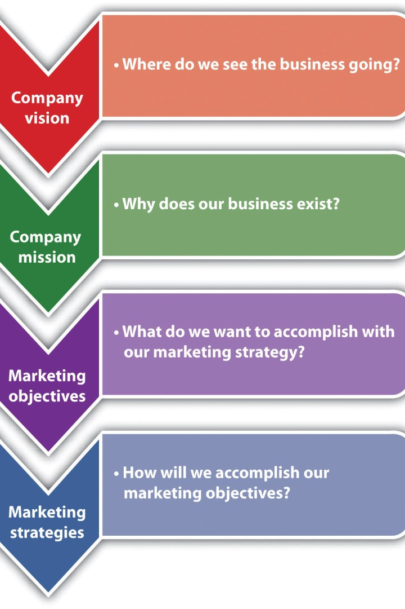
Visionary Branding: Elevating Online Experiences
Social Enhance's innovative initiatives aim to elevate online experiences, connect communities, and drive meaningful engagement through visionary branding strategies that resonate with the digital audience.

Slide 10

Dynamic Transformation: Amplifying Digital Presence
Social Enhance's commitment to pushing the boundaries of social and digital enhancement paves the way for dynamic transformation, ensuring an amplified digital presence and impactful engagement with the target audience.

